Slide 1
Course : Computational Biology
Effective Period : June 2022
Genomics

Slide 2
Learning Objectives
Genome Structure and Organization
Central Dogma of Molecular Biology
DNA and RNA
DNA Replication
DNA Mutation

Slide 3
Bioinformatics and System Biology
This has led to the development those studies on three different aspects of life sciences which are Genomics, Proteomics, and Metabolomics makes the integration of all these aspects is well known to be a System Biology
Genomics
Studies of the genetic make-up of organisms
Proteomic
Studies of the structure and function of proteins. What they do, what they interact with, and how they contribute to life processes
Metabolomics
Comprehensive and simultaneous studies of metabolites at the systemic levels and their changes over time as consequences of stimuli

Slide 4
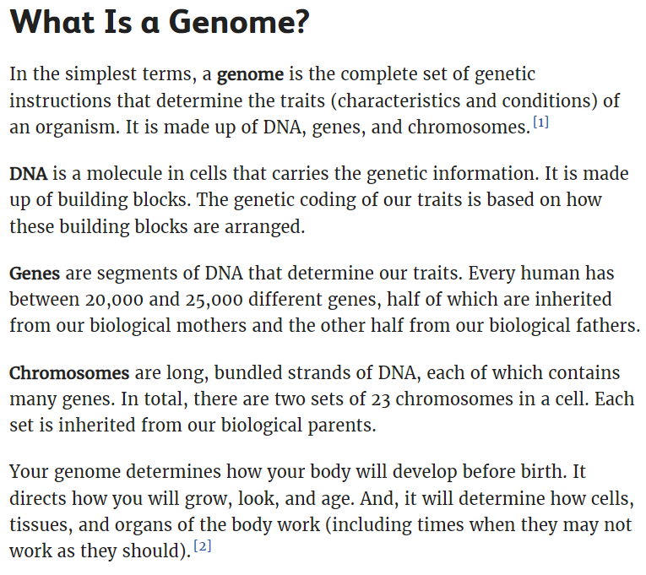
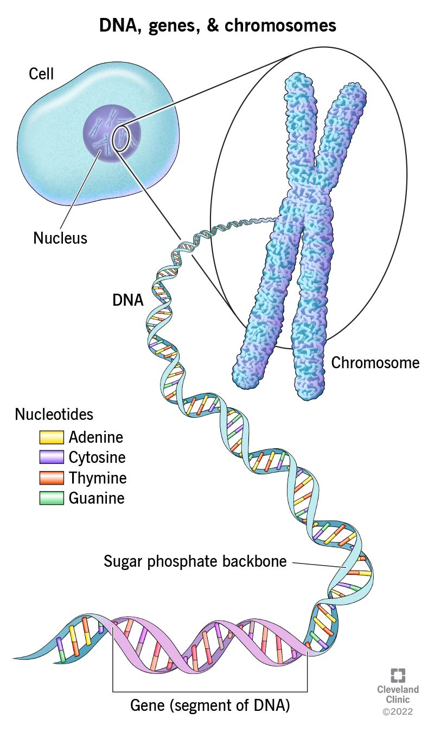

Slide 5
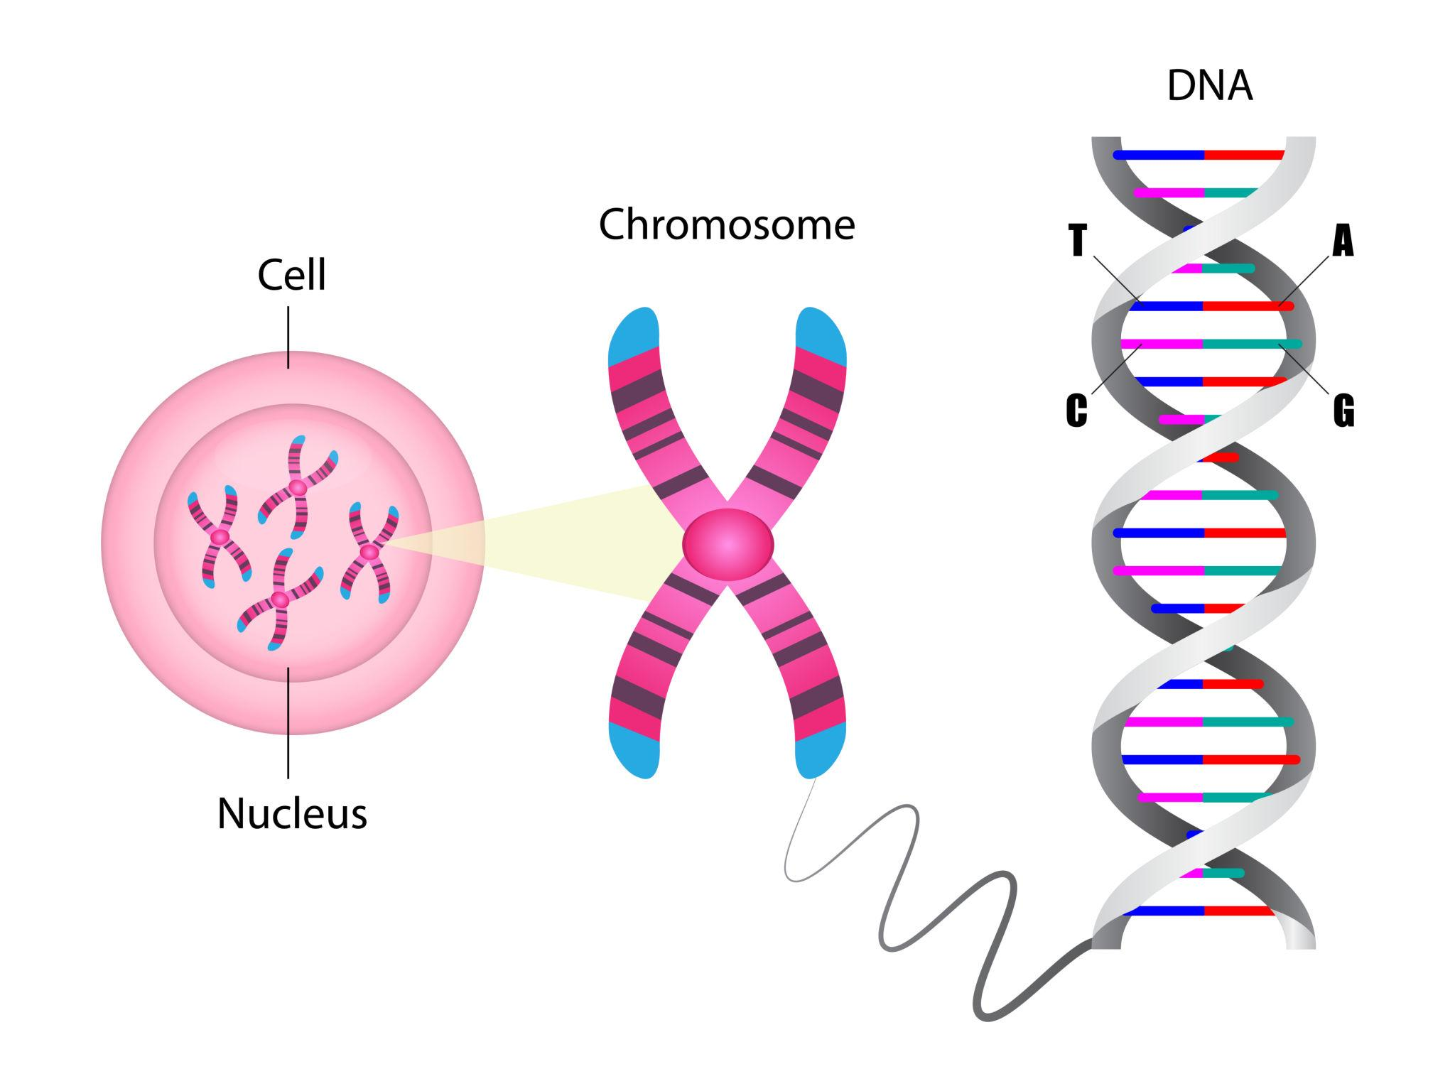
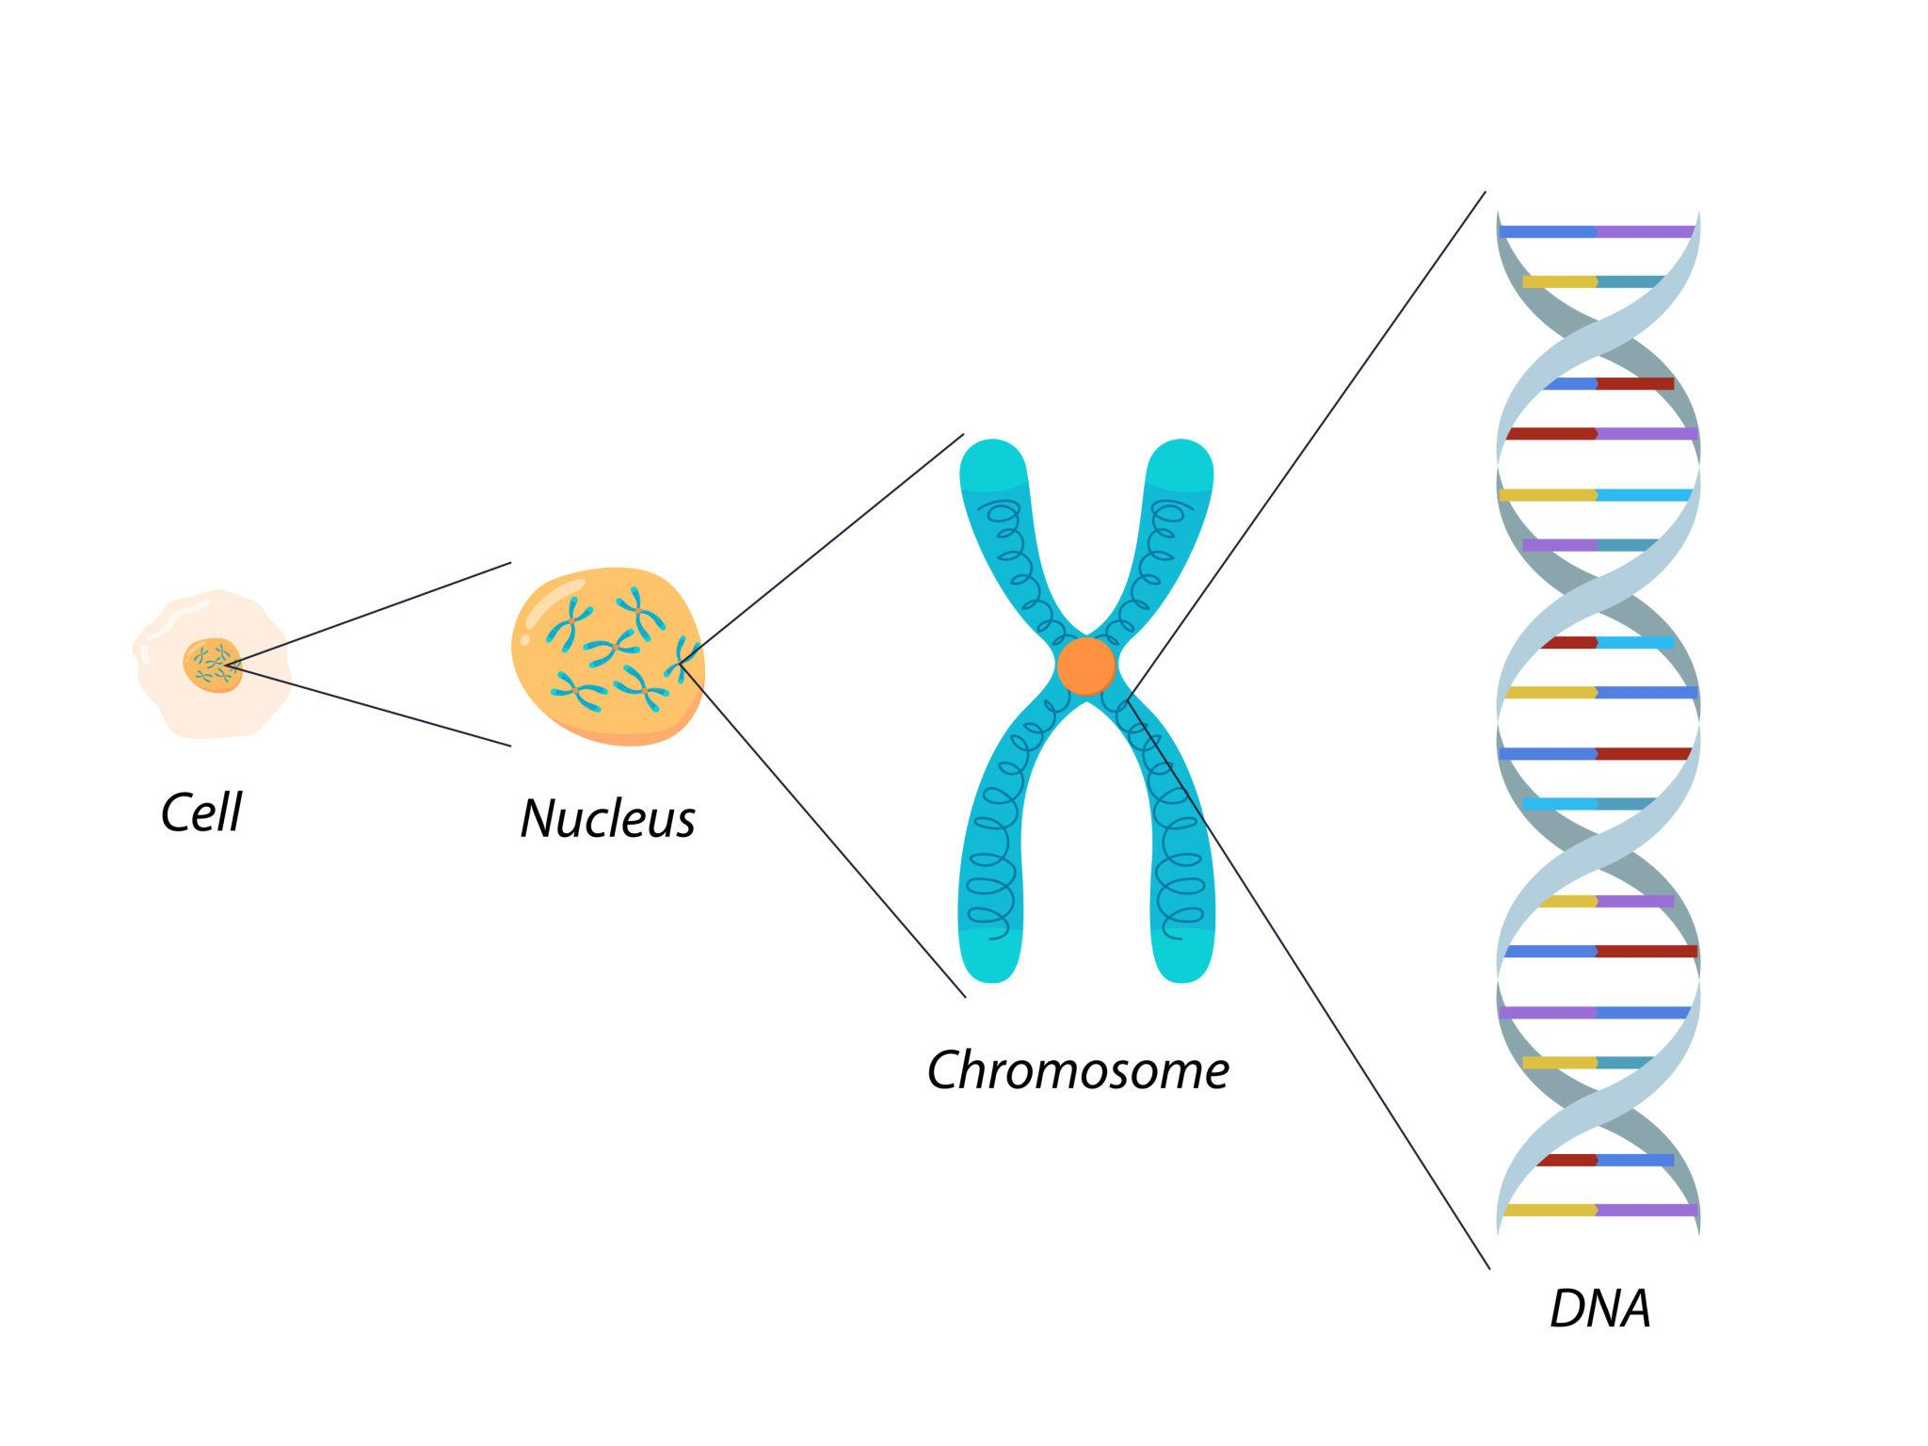
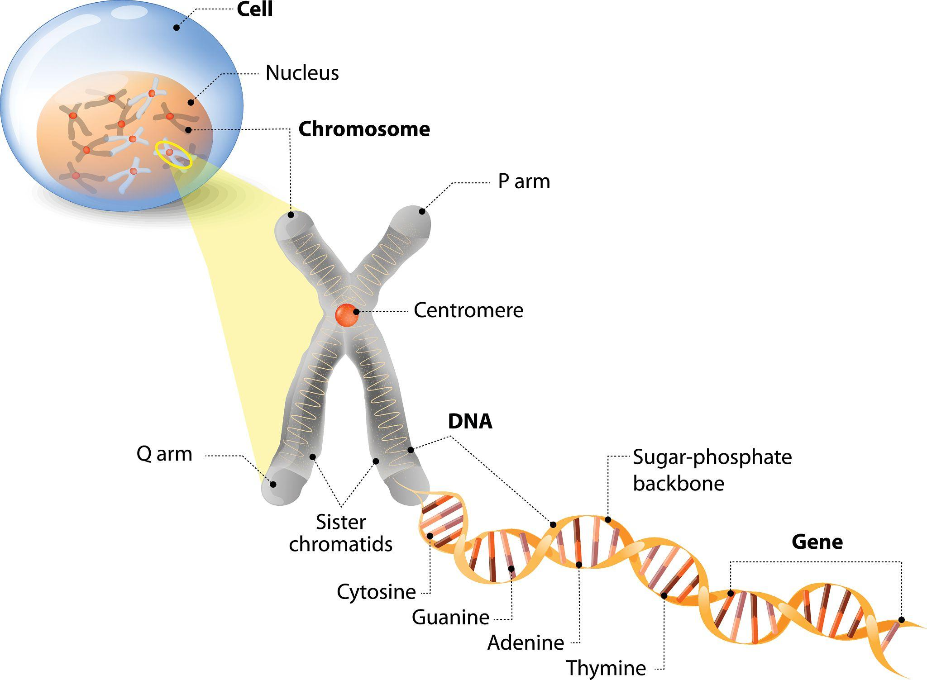
Genome adalah keseluruhan materi genetik yang dimiliki oleh suatu organisme.
Genome menentukan sifat, perkembangan, dan fungsi organisme
Genome tersusun dari:
  DNA
  Gen
  Kromosom
Genome ≠ gen tunggal
📌 Genome = total informasi genetik

Slide 6
DNA
DNA (Deoxyribonucleic Acid) adalah molekul pembawa informasi genetik.
Ciri utama DNA:
Berbentuk double helix
Tersusun dari nukleotida A, T, G, C
Sangat panjang
Menyimpan semua informasi genetik
📌 DNA = media/penyimpan informasi
Gen adalah bagian (segmen) tertentu dari DNA yang memiliki fungsi biologis.
Ciri utama gen:
Panjangnya hanya sebagian kecil dari DNA
Mengandung instruksi untuk:
  protein, atau
  RNA fungsional
Memiliki lokasi spesifik di kromosom (lokus)
📌 Gen = instruksi fungsional

Slide 7
Whole genomes can be sequenced and mapped
In 1995, a team of biologists announced they had determined the DNA sequence of the entire genome of Haemophilus influenzae, a disease-causing bacterium.
This marked the first successful experiment in genomics, the science of studying the complete sets of genes (genomes) and their interactions.

Slide 8
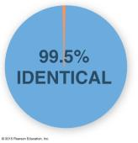
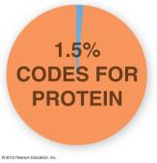
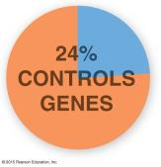
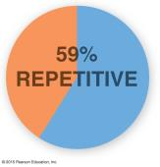
The Human Genome Project was completed in 2003
The human genome contains 21,000 genes that encode for 100,000 different proteins.
The data are providing insight into development, evolution, and many diseases.
Human Genome Facts
Notes:
Figure 6.18-1d The Human Genome Project–4 of 7
Figure 6.18-1e The Human Genome Project–5 of 7
Figure 6.18-1f The Human Genome Project–6 of 7
Figure 6.18-1g The Human Genome Project–7 of 7

Slide 9
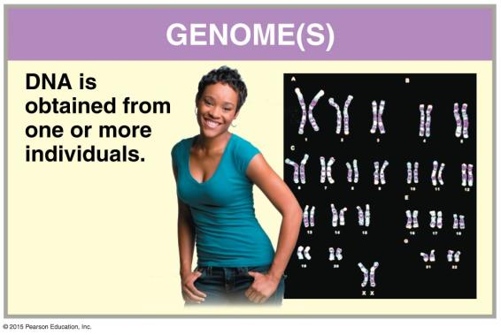
Genome mapping involved several separate techniques
The set of techniques used to sequence an entire genome from an organism is called the whole-genome shotgun method.
Notes:
Figure 6.18-2a Whole-Genome Shotgun Method–1 of 11

Slide 10
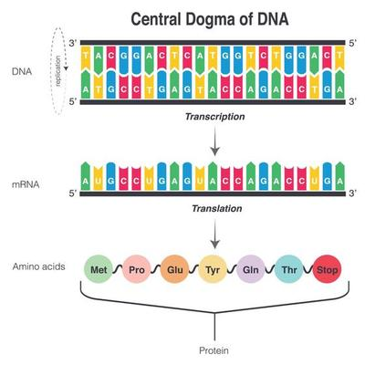
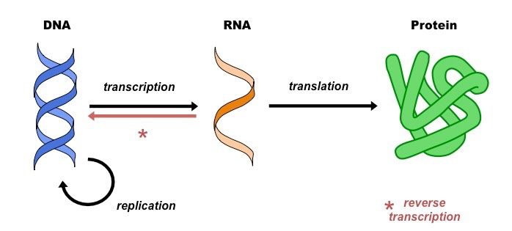
Central Dogma
The central dogma of molecular biology is an explanation of the flow of genetic information within a biological system. It is often stated as "DNA makes RNA, and RNA makes protein", It was first stated by Francis Crick in 1957, then published in 1958
3 Process of central dogma
From existing DNA to make new DNA (replication)
From DNA to make new RNA (transcription)
From RNA to make new proteins (translation).
This process of genetics information flowing from
DNA to RNA to Protein is called gene expression.

Slide 11
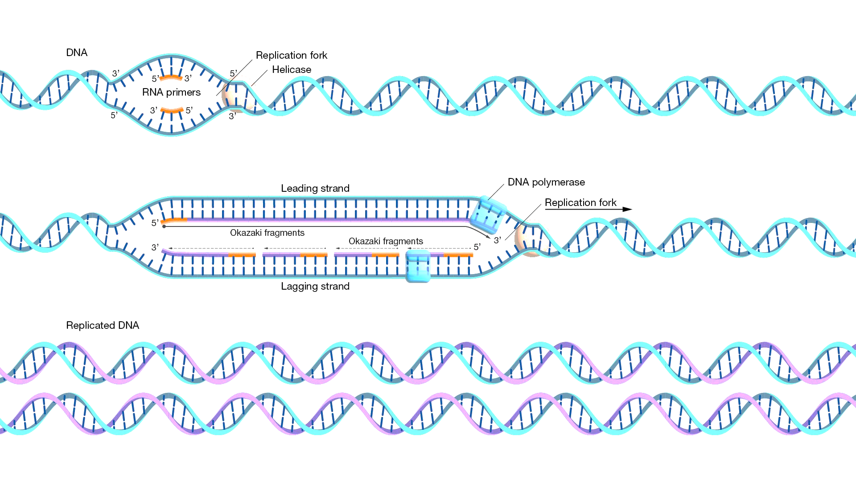
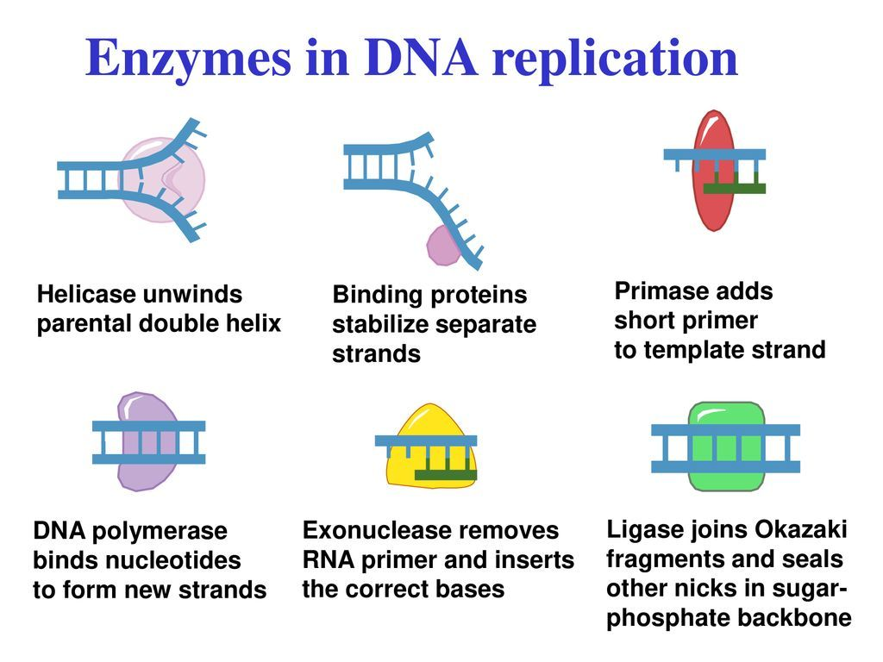
Replication
DNA replication is the process by which the genome’s DNA is copied in cells.
Before a cell divides, it must first copy (or replicate) its entire genome so that each resulting daughter cell ends up with its own complete genome.
DNA replication is probably one of the most amazing tricks that DNA does. If you think about it, each cell contains all of the DNA you need to make the other cells.
And we start out from a single cell and we end up with trillions of cells. And during that process of cell division, all of the information in a cell has to be copied, and it has to be copied perfectly.

Slide 12
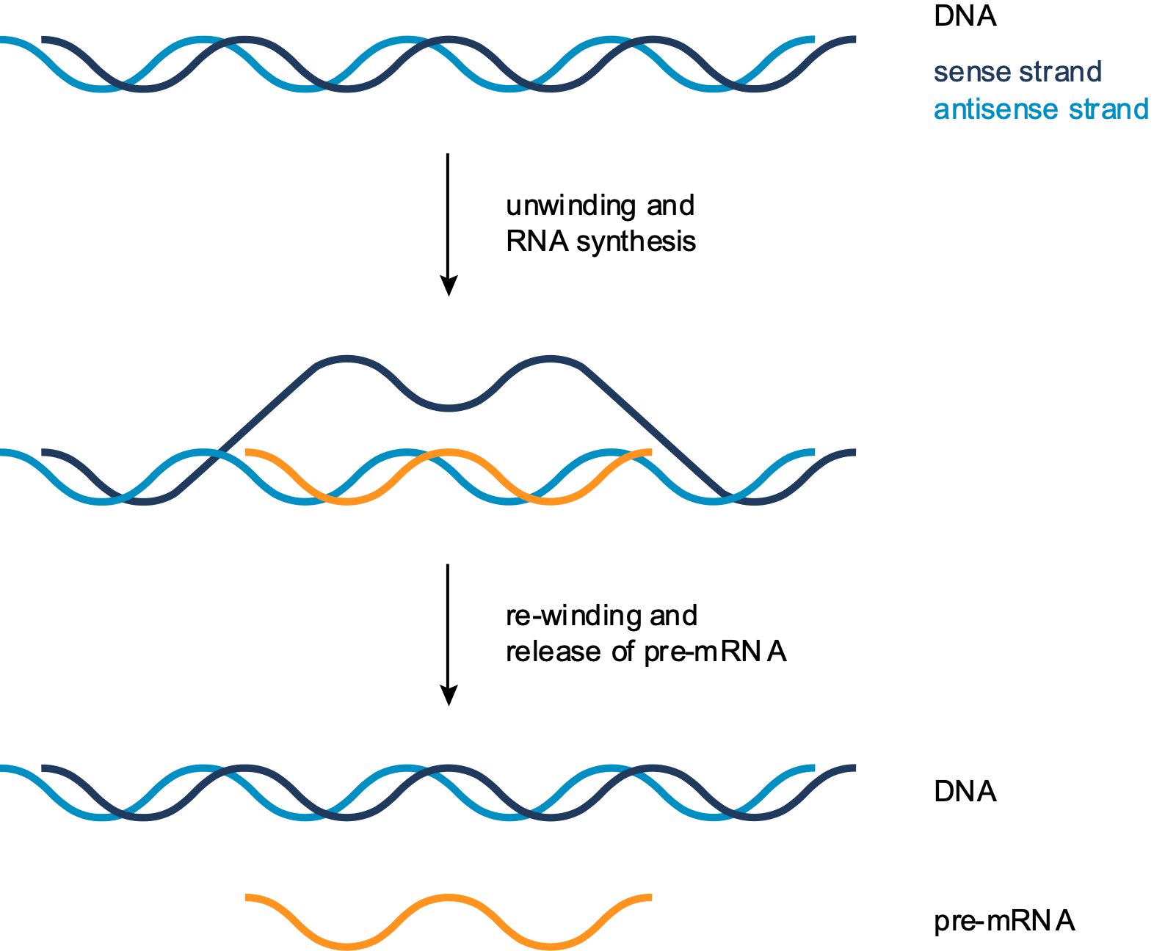
Central Dogma - Transcription
Transcription is the process by which DNA is copied (transcribed) to mRNA, which carries the information needed for protein synthesis.
Transcription takes place in two broad steps.
First, pre-messenger RNA is formed, with the involvement of RNA polymerase enzymes. The process relies on Watson-Crick base pairing, and the resultant single strand of RNA is the reverse-complement of the original DNA sequence.
The pre-messenger RNA is then "edited" to produce the desired mRNA molecule in a process called RNA splicing.

Slide 13
Nucleic Acid
There are two families of nitrogen bases, namely purines and pyrimidines, which are cyclic rings with C and N atoms.
Purine is a two-ring molecule. Which include purines are Adenine (A) and Guanin (G).
Pyrimidine is a single ring molecule. Those included pyrimidines are Cytosine (C), Thymine (T) and Uracil (U).
Adenine, Guanine and Cytosine are found in both types of nucleic acids. The thymine is found only in DNA, and Uracil is found only in RNA.

Slide 14
Nucleic Acid
Nucleic acid is an information polymer in cells.
There are two types of nucleic acids, namely deoxyribonucleic acid (DNA = Deoxiribo Nucleic Acid) and Ribonucleic Acid (RNA = Ribo Nucleic Acid).
Nucleic acid is a polymer of monomers called nucleotides.
Each nucleotide consists of three parts, namely:
-. An organic molecule called a nitrogen base.
-. A five-carbon sugar, pentose.
-. A phosphate group.

Slide 15
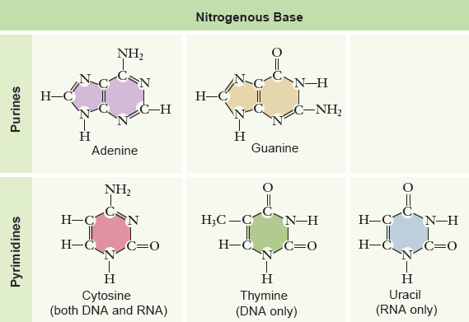

Slide 16
Nucleic Acid
There are two types of pentoses that bind to a nitrogen base, namely ribose on nucleotide RNA and deoxyribose in DNA nucleotides.
The difference between these two pentoses is that deoxyribose does not have an oxygen atom bonded to C number 2, thus making its name deoxy.
The phosphate group binds to the number 5 C atom on pentose sugar.
The molecular structure of nitrogenous bases, pentoses and phosphate groups is known as nucleoside monophosphate.

Slide 17
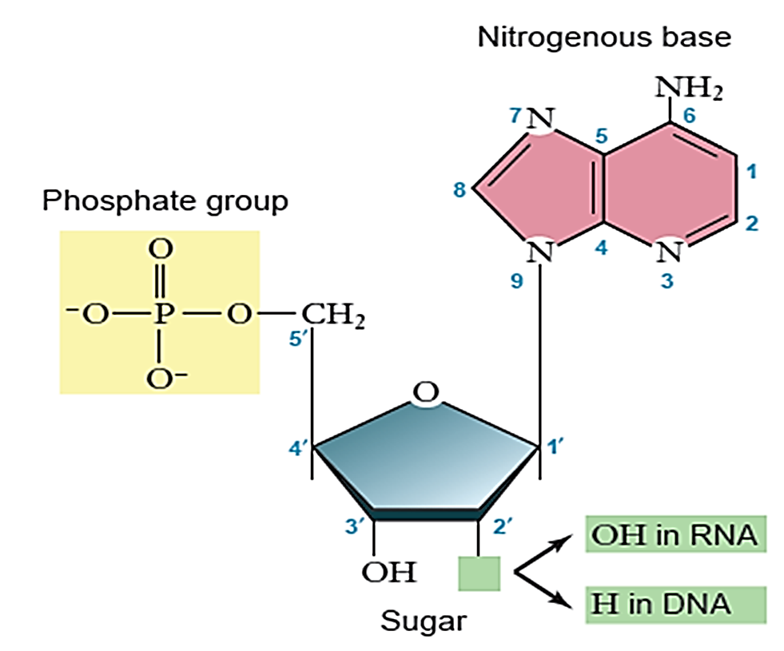

Slide 18
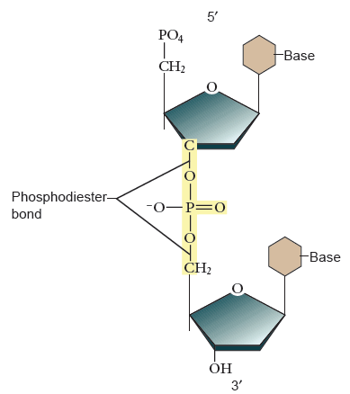
Nucleic Acid
In nucleic acid polymers and polynucleotides, nucleotides are associated with a covalent bond called a phosphodiester bond between a phosphate of a nucleotide and a pentose from the next nucleotide.
This binding produces a backbone with a repeating pattern of pentose-phosphate-phosphate.

Slide 19
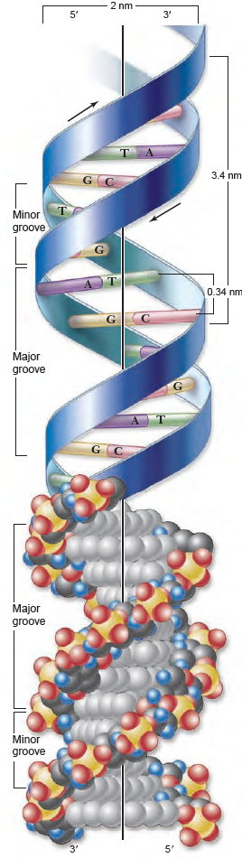
DNA
The DNA molecule actually consists of two strands of polynucleotide forming a spiral around an imaginary growing to form a double helix.
Both the pentose-phosphate-pentose-phosphate spine are outside the helix, and the nitrogen base in pairs between the two polynucleotides is inside the helix.
The two strands of polynucleotide are bonded by hydrogen bonds between the nitrogenous bases that are paired inside the helix. A paired with T through 2 hydrogen bonds and G paired with C through 3 hydrogen bonds.

Slide 20
DNA
Double helical DNA has a diameter of 20 Å. Each round of helix contains 10 pairs of bases. The distance between one round is 3.4nm (34 Å). So the distance between the bases is 0.34 nm. DNA generally forms a right-handed helix of B. Form. Also known as A and Z form. B-shaped double helix DNA is usually found in physiologic conditions of low salt, high degree of hydration.
DNA molecules are very long molecules with thousands or even millions of other bases. However, to express the length of the DNA molecule, it is expressed by bp (base pairs). 1 Kbp = 1,000 bp.

Slide 21
In a double helix, a particular base fits only in pairs with another base. Adenine (A) is always paired with Thymine (T). Guanine (G) is always paired with Cytosine (C). To facilitate the writing of the nitrogen base is always written with the abbreviation ATGC, and usually the backbone is not written back.
An example of a stretch of DNA can be exemplified as follows:
AATTGCGCTTGGATAT
TTAACGCGAACCTATA
It is seen here that the double helix nitrogen base strands of DNA are complementary

Slide 22
However, double-helical strands of DNA are also antiparallel or mutually inverse. This will be very important in the process of DNA replication and transcription. Consider the pentose with five carbon atoms (C). Each atom is marked with numbers 1 'to 5'. When considered in the picture then it looks that:
The phosphate group is connected to the outermost nucleotide pentose C 5. This end is given the 5 'end.
The phosphate group of a nucleotide is connected to C 5 'pentoses with the nearest C 3' pentose nucleotides.
In other outer end nucleotides there is C 3 'pentose which has one hydroxyl group (OH). This end is given the 3 'end.
Basic sequence writing is generally from 5 'to 3'

Slide 23
DNA is the genetic material that an organism inherits from its mother. A DNA molecule is very long, and generally consists of hundreds or even thousands of genes. The gene is a unit of decline in genetic properties. Another definition, a gene is an area of DNA whose product can eventually be a polypeptide or it could be an RNA molecule.
DNA is a unique molecule among the molecules that exist because it can direct its own replication and direct the synthesis of RNA, and control protein synthesis through RNA.
That is, when a cell reproduces by splitting, its DNA will be copied and passed from one generation of cells to the next. The information encoded in the DNA structure reprogrammed all of the cell's activity, but DNA was not directly involved in the execution of cell activity.

Slide 24
BASIC CHARACTERISTICS OF
DNA REPLICATION
Meselson and Stahl demonstrate the semiconservative mechanism:
Semiconservative replication uses each strand of a DNA molecule to specify the synthesis of a new strand.
Meselson and Stahl showed this by using a heavy isotope of nitrogen and separating the replication products.
Replication produces two new molecules each composed of one new strand and one old strand.

Slide 25
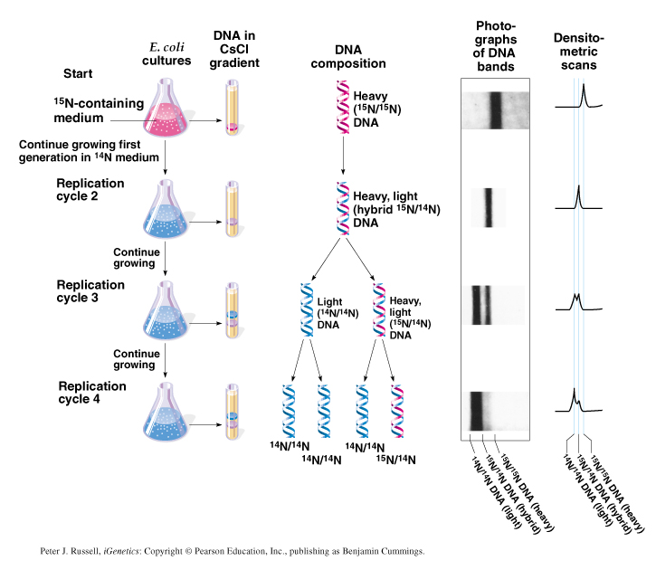
THE MESELSON–STAHL EXPERIMENT

Slide 26
DNA replication requires a template, nucleotides, and a polymerase enzyme:
All new DNA molecules are produced by DNA polymerase copying a template. All known polymerases synthesize new DNA in the 5'-to-3' direction.
These enzymes also require a primer. The building blocks used in replication are deoxynucleotide triphosphates with high-energy bonds; they do not require any additional energy.

Slide 27
SEMICONSERVATIVE
DNA REPLICATION
Watson and Crick DNA model implies a mechanism for replication:
Unwind the DNA molecule.
Separate the two strands.
Make a complementary copy for each strand.

Slide 28
SEMICONSERVATIVE
DNA REPLICATION
Three possible models were proposed for DNA replication:
Conservative model proposed both strands of one copy would be entirely old DNA, while the other copy would have both strands of new DNA.
Dispersive model was that dsDNA might fragment, replicate dsDNA, and then reassemble, creating a mosaic of old and new dsDNA regions in each new chromosome.
Semiconservative model is that DNA strands separate, and a complementary strand is synthesized for each, so that sibling chromatids have one old and one new strand. This model was the winner in the Meselson and Stahl experiment.

Slide 29
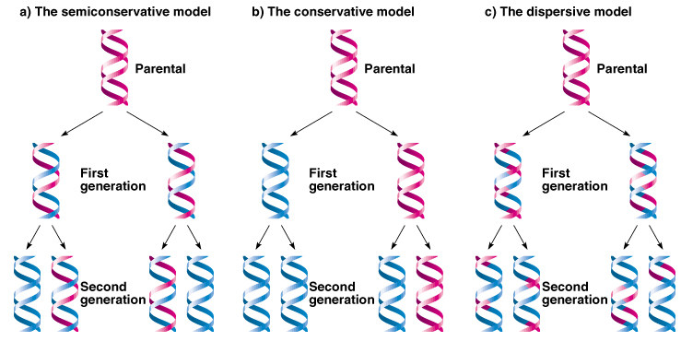
SEMICONSERVATIVE DNA REPLICATION

Slide 30
PROKARYOTIC REPLICATION
Prokaryotic replication starts at a single origin.
The E. coli origin has AT-rich sequences that are easily opened. The chromosome and its origin form a replicon.
E. coli has at least three different DNA polymerases.
Some DNA polymerases can also degrade DNA from one end, called exonuclease activity.
Pol I, II, and III all have 3'-to-5' exonuclease activity that can remove mispaired bases. Pol I can remove bases in the 5'-to-3' direction, important to removing RNA primers

Slide 31
Unwinding DNA requires energy and causes torsional strain:
DNA helicase uses energy from ATP to unwind DNA. The torsional strain introduced is removed by the enzyme DNA gyrase.
Replication is semidiscontinuous:
Replication is discontinuous on one strand (see figure). The continuous strand is called the leading strand, and the discontinuous strand is called the lagging strand.

Slide 32
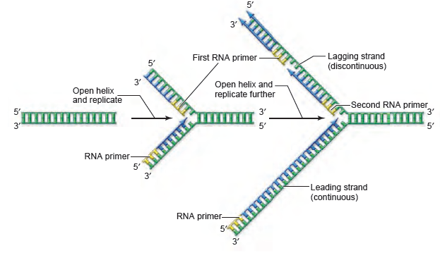
REPLICATION IS SEMIDISCONTINUOUS

Slide 33
Synthesis occurs at the replication fork:
The partial opening of a DNA strand forms two single-stranded regions called the replication fork.
At the fork, synthesis on the leading strand requires a single primer, and the polymerase stays attached to the template because of the β subunit that acts as a sliding clamp.
On the lagging strand, DNA primase adds primers periodically, and DNA Pol III synthesizes the Okazaki fragments.
DNA Pol I removes primer segments, and DNA ligase joins the fragments.

Slide 34
The replisome contains all the necessary enzymes for replication:
The replisome consists of two copies of Pol III, DNA primase, DNA helicase, and a number of accessory proteins.
It moves in one direction by creating a loop in the lagging strand, allowing the antiparallel template strands to be copied in the same direction (see figures below)

Slide 35
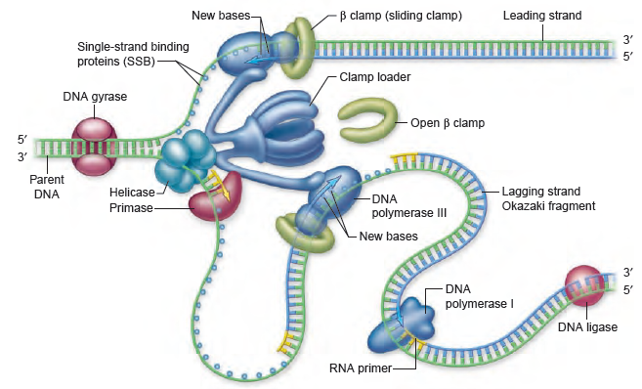

Slide 36
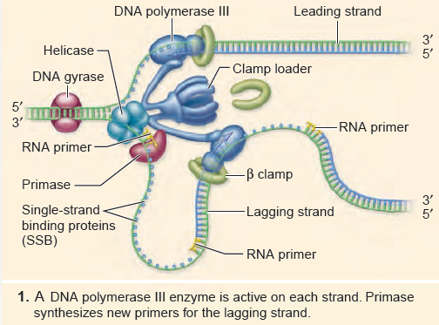

Slide 37
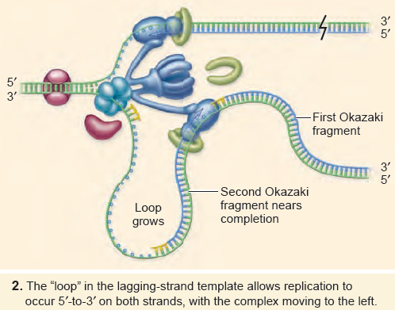

Slide 38
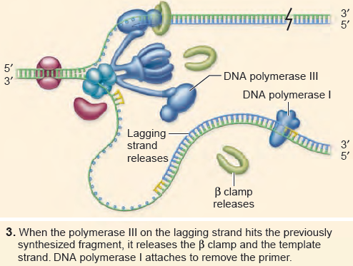

Slide 39
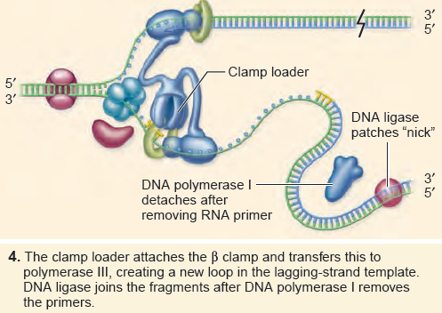

Slide 40
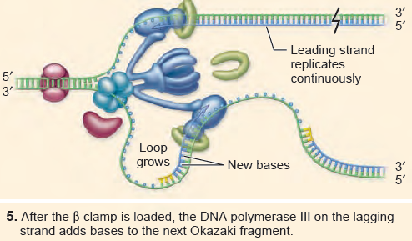

Slide 41
EUKARYOTIC REPLICATION
Eukaryotic replication requires multiple origins:
The sheer size and organization of eukaryotic chromosomes requires multiple origins of replication to be able to replicate DNA in the time available in S phase.
The enzymology of eukaryotic replication is more complex:
The eukaryotic primase synthesizes a short stretch of RNA and then switches to making DNA. This primer is extended by the main replication polymerase, which is a complex of two enzymes. The sliding clamp subunit was originally identified as protein produced by proliferating cells and is called PCNA.

Slide 42
Archaeal replication proteins are similar to eukaryotic proteins:
The replication proteins of archaea, including the sliding clamp, clamp loader, and DNA polymerases, are more similar to those of eukaryotes than to prokaryotes.
Linear chromosomes have specialized ends:
The ends of linear chromosomes are called telomeres. They are made by telomerase, not by the replication complex.
Telomerase contains an internal RNA that acts as a template to extend the DNA of the chromosome end.
Adult cells lack telomerase activity, and telomere shortening correlates with senescence.

Slide 43
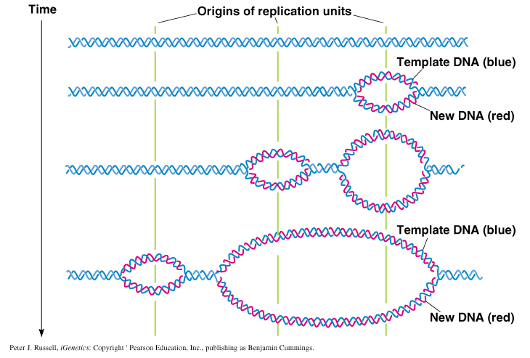
Temporal ordering of DNA replication initiation events
in replication units of eukaryotic chromosomes

Slide 44
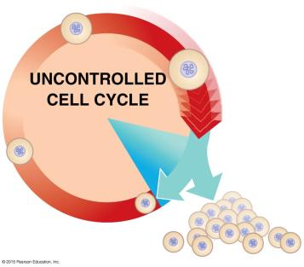
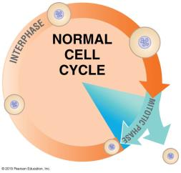
DNA MUTATION
Loss of gene expression control can result in cancer
Mutations can lead to a mass of body cells growing out of control, a tumor.
If a tumor spreads to other tissues, the person is said to have cancer.
Notes:
Figure 6.11-1d
Figure 6.11-1e
Cancer is caused by out-of-control cell growth due to a breakdown of the cell cycle control system.

Slide 45
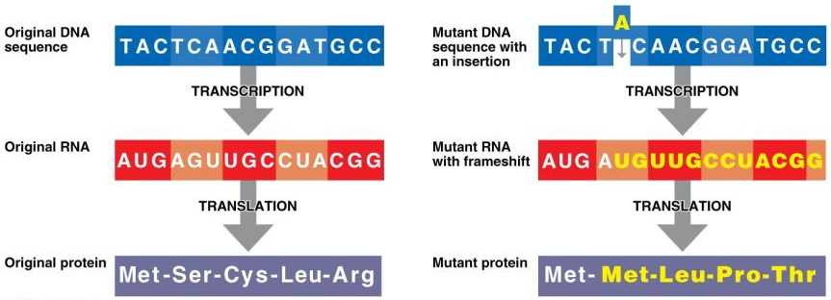
DNA MUTATION
Frameshift mutations are due to the addition or deletion of a nucleotide. Frameshift mutations often result in different or defective proteins.
Added A
Notes:
Figure 6.10-3 Frameshift Mutations

Slide 46
DNA REPAIR
Cells are constantly exposed to DNA-damaging agents:
Errors from replication and damage induced by agents such as UV light and chemical mutagens can lead to mutations.
DNA repair restores damaged DNA:
Without repair mechanisms, cells would accumulate mutations until inviability occurred.
Repair can be either specific or nonspecific:
The enzyme photolyase uses energy from visible light to cleave thymine dimers caused by UV light. Excision repair is nonspecific. In prokaryotes, the uvr system can remove a damaged region of DNA.

Slide 47
DNA MANIPULATION
Restriction enzymes cleave DNA at specific sites:
DNA molecules fragmented by known type II restriction endonucleases can be ordered into a physical map of DNA.
DNA ligase allows construction of recombinant molecules:
Just as in DNA replication, DNA ligase catalyzes formation of a phosphodiester bond between nucleotides, forming a recombinant molecule.

Slide 48
DNA MANIPULATION
Transformation allows introduction of foreign DNA into E. coli:
Artificial transformation techniques introduce foreign DNA into E. coli cells, which are then termed transgenic.

Slide 49
Genomics Application : Molecular Cloning
Host–vector systems allow propagation of foreign DNA in bacteria:
Plasmids, and artificial chromosomes can be used as vectors.
Foreign DNA is inserted using restriction enzymes and DNA ligase; once the vector is inside the host cell, it is replicated during the cell cycle.
DNA libraries contain the entire genome of an organism:
A DNA library is a complex mixture of DNAs collected into vectors. These libraries may be probed for a sequence of interest.

Slide 50
Genomics Application : Molecular Cloning
Reverse transcriptase can make a DNA copy of RNA:
A library can also be created for the expressed parts of the genome by isolating RNA and converting it to cDNA using the enzyme reverse transcriptase
Hybridization allows identification of specific DNAs in complex mixtures:
DNA can be reversibly denatured and renatured, resulting in single- and then double-stranded DNA.
Renaturation of complementary strands from different sources is called HYBRIDIZATION. Known DNA can be labeled to identify complementary strands.

Slide 51
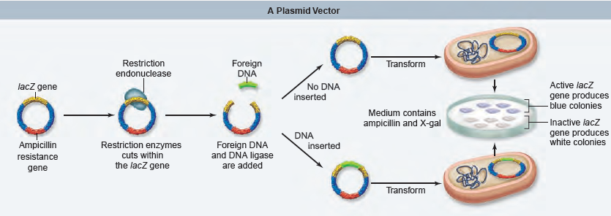
Genomics Application : Molecular Cloning
Specific clones can be isolated from a library:
Hybridization is the most common way to identify a gene of interest in a library.
MOLECULAR CLONING WITH VECTORS

Slide 52
References
Lesk, Arthur M.. (2014). Introduction to Bioinformatics. 4. Oxford University Press, United Kingdom. ISBN: 978-0199651566. (*)
Choudhuri, S.. (2014) Bioinformatics for Beginners: Genes, Genomes, Molecular Evolution, Databases and Analytical Tools. Elsevier. ISBN 978-0124104716.
Simon, E. J.. (2020). Biology : The Core. 3rd Edition. Pearson: Hoboken, NJ. ISBN 9780134891514

